Slide 1
Trees

Slide 2
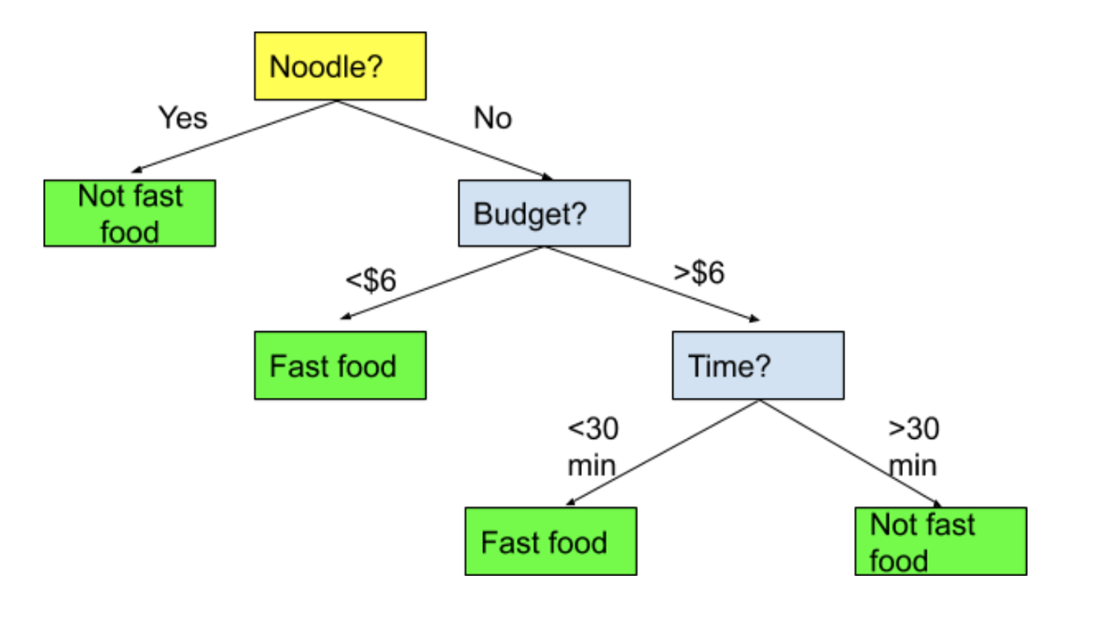
Trees
Trees are one of the most simple to understand models in machine learning.
A tree is just a series of if statements, until a decision is reached.
Once the tree is made, making a prediction is dead simple, just follow the tree and make decisions.
E.g. a “Fast Food” vs “Not Fast Food” classification model.

Slide 3
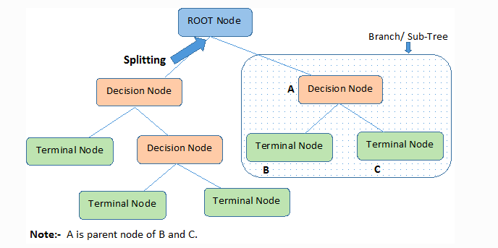
Tree Parts
The parts of a tree are simple and tree like:
Node– each point.
Decision – node where a split is made.
Terminal/leaf – node where a value is determined.
Brach/Sub-Tree – a segment of a larger tree.
Depth – how many layers the tree has.

Slide 4
Building the Tree
The decisions and the cutoffs are created by looking at the features for the criteria that will do the “best job of deciding” – or that will split the group most sharply.
For example:
You are classifying people as horse jockeys or basketball players.
You know their height and hair color.
Height does a better job of splitting the records.
Those >6ft are almost all basketball players.
Those <6ft are almost all jockeys.
Your choice would be to divide the data based on height.
The algorithm finds the decisions that maximize this separation.

Slide 5
Criteria
The criteria for how good the separation can be defined by different metrics.
Gini.
Entropy.
The math behind each is different, the idea is the same.
Gini is the default (in sklearn, others may vary).
Gini tends to be more computationally efficient.

Slide 6
Scenario
If we have 4 red gumballs and 0 blue gumballs, that group of 4 is 100% pure.
If we have 2 red and 2 blue, that group is 100% impure.
If we have 3 red and 1 blue, that group is either 75% or 81% pure, if we use Gini or Entropy respectively.

Slide 7
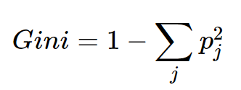
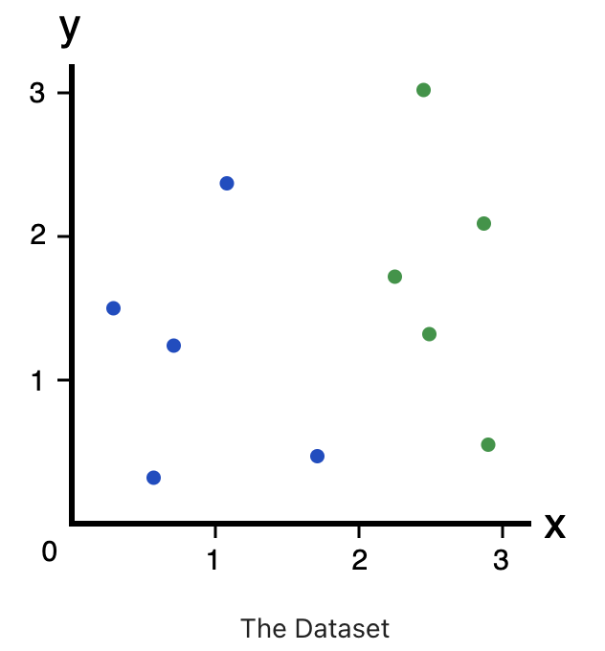
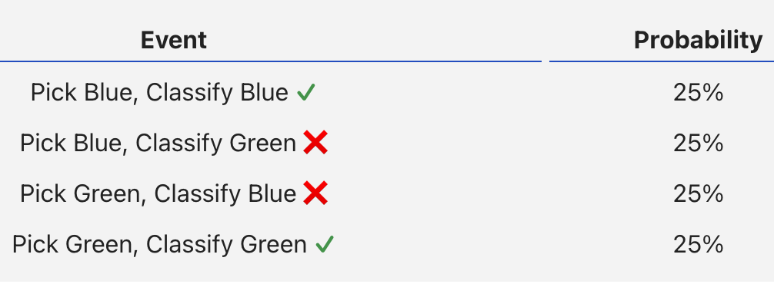
Gini
Gini measures how often a randomly chosen element from the set would be incorrectly labeled.

Slide 8
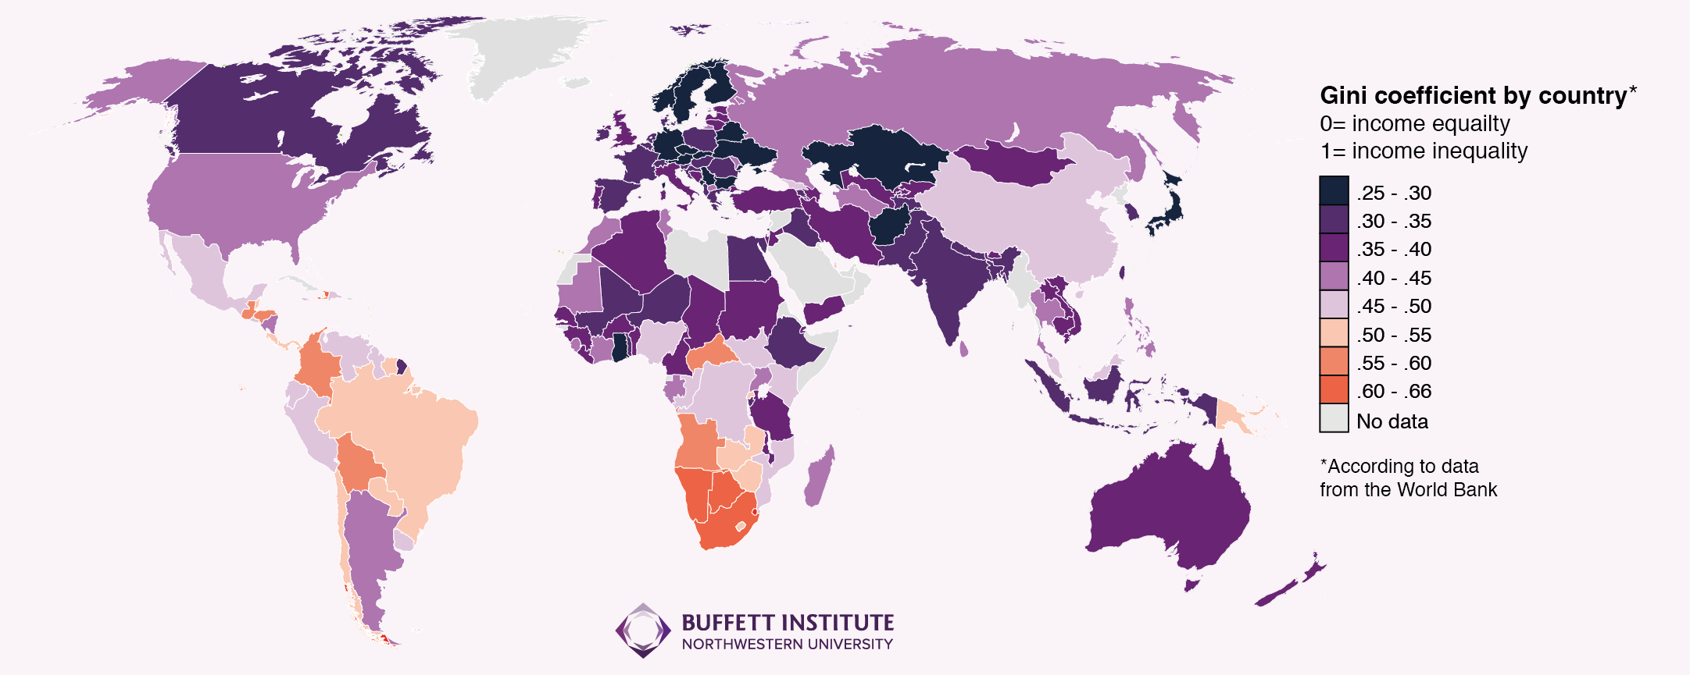

Slide 9
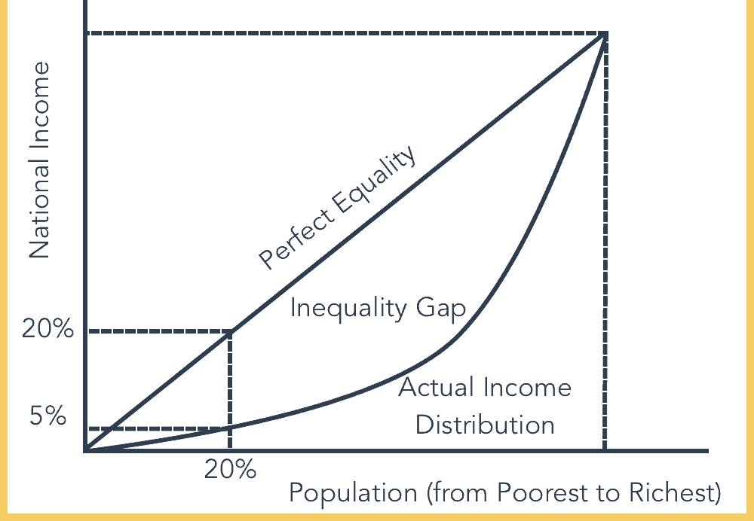
Side Note - Gini Coefficient

Slide 10
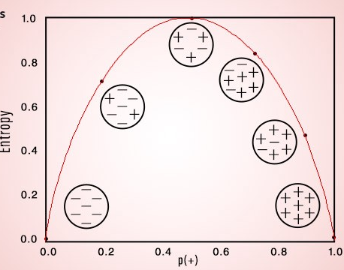
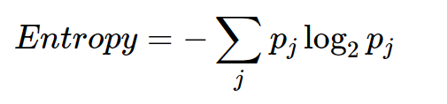
Entropy
Entropy is similar to Gini – a measure of impurity.
Created to convey the idea of information – the lower the entropy the more “information” it conveys.

Slide 11
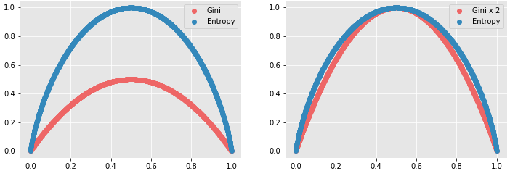
Splitting Decision
The algorithm looks for the decision that maximizes information gain or purity.
Gain = Gini/ENT before the split – Gini/ENT after the split
The split is the one that makes the tree the most pure after.
The decision at the splitting node is whatever decision does the best job of discriminating.
The series of the decisions makes the tree sequence of decisions.
In practice Gini and Entropy will usually give similar results

Slide 12
Tree Construction
Look at the data.
Choose whichever split gives the highest information gain.
Note: if dealing with a numeric feature, the criteria is just <> instead of picking a class.
Repeat until there are no more possible splits, or a limit is reached.
Note: a single variable can be use for more than one split decision.
To make a prediction, start at the top, follow the decisions down the tree.

Slide 13
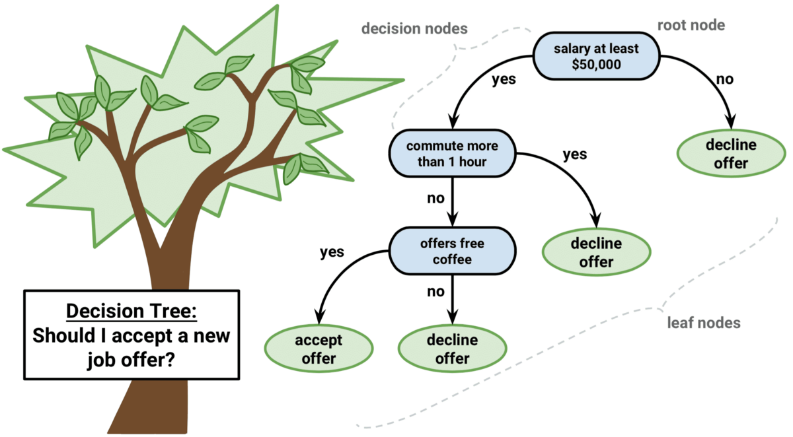
$72,000 salary, 39 min commute, no Coffee

Slide 14
Woody Goodness
Tree benefits:
Simple, understandable, and mirrors human decision making.
Handles non-linear relationships.
Explainable – we can follow the exact logic of the decisions.
Data prep is minimal – no need to encode or scale data.
Note: specific implementations of a tree may require encoding.
Generally computationally efficient with large datasets when making decisions.
Can be acceptable in scenarios (finance, insurance, etc…) where a black box model isn’t.
Models that make unexplainable decisions may not be viable if oversight is needed.

Slide 15
Barky Badness
Trees have some disadvantages:
Non-robust – small changes in training data can generate wildly different trees.*
Prone to overfitting (though we can combat that when we code them).
Training with large datasets can be time consuming, especially when attempting to limit overfitting.
* If one small change happens to the training data, the most suitable split at a node may be different, this can cause all of the subsequent nodes to be different. The overall predictions may be similar, but the tree’s structure can vary widely.

Slide 16
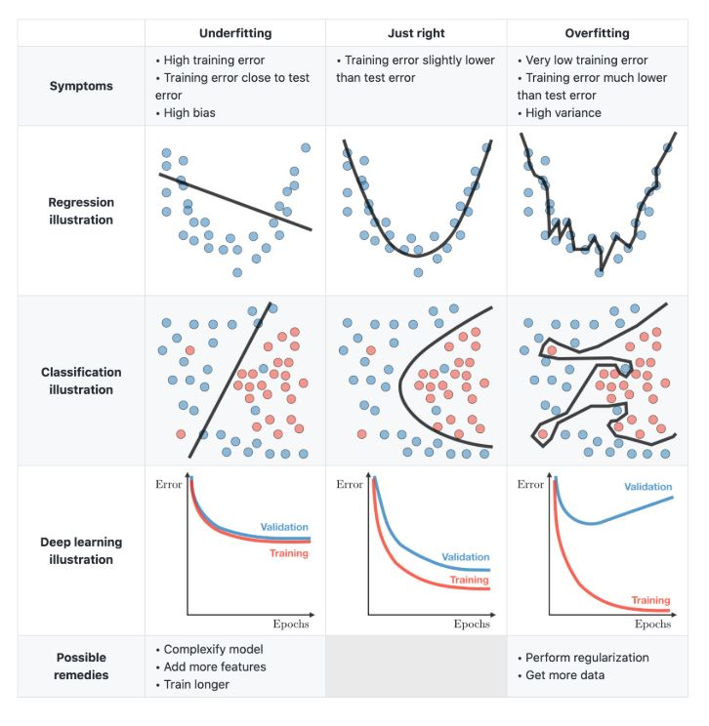
Tree Problems
One common issue with trees is overfitting to training data.
Think back to the bball/jockey example:
If we reach a leaf with two items, one of each.
The algo. will aim to split the two, based on something.
Result is two perfectly pure leaves, with 1 item each.
This is rarely a generalizable split. (All the “effective” splits were done earlier, this one is looking “too close”.)
This is overfitting – we’ve customized too much to the training data.

Slide 17
Over or Underfitting
Overfitting and underfitting are something we’ll look at several times.
In general, we want a model that has:
Learned enough from our training data that it is tailored to the type of data.
Not so specific that it doesn’t translate well to new data.
Trees allow us to see the excess fitting visually in the lower leaves.
We normally want to restrict the algorithm in some way from going “too far”:
For a tree, we can limit overfitting in advance or after the fact.
In general, our models are trying to be as accurate as they can be, and we are setting restrictions, through many methods, on their “learning” to prevent overfitting.

Slide 18
EDA and Classes

Slide 19
EDA and Classes – DataFrame Class Object
Methods:
Head
Info
Attributes:
Data
Columns
Size

Slide 20
Using a Class - Dataframe
When we create a DF we instantiate, or create an object of, that class.
Df = pd.read_csv(“some_data.csv”)
That object, df, has all the stuff in the previous image – the data, attributes, and functions.
Df.columns:
Give me the value of that attribute.
Df.head():
Run this function on the object

Slide 21
We can Make A Class – for EDA
We can try to make our own class, to help with EDA, what should it contain?
Attributes:
A dataframe. (An object in an object).
Some other helpful stuff? E.g. a list of categorical variables.
Functions:
Generate histograms.
Print EDA stuff.
Use:
Create an “EDA” object by loading the dataframe we are using.
Call the “give me EDA” function to get it all spit out for us.
We can reuse this by creating an EDA object for each df, then we can just call the EDA function.
Note: We can also extend classes – or basically make a “dataframe+” adding what we want. We’ll do this later for transformations.

Slide 22
EDA and Classes – DataFrame Class Object
Methods:
Make_EDA
Attributes:
Dataframe

